Slide 1
Dungeon Daredevil
Papa John’s Kool Coding Klub

Slide 2
Progression of specifications

Slide 3
Original plans for release schedule
Release Name | New incremental features of release
1.0.0 | Loading Maps
1.1.0 | Player Movement
1.2.0 | Enemies
1.3.0 | Combat
1.3.1 | Weapons
1.3.2 | Bullets
1.3.3 | Hit detection
1.4 | AI
1.4.1 | Enemy Movement
1.4.2 | Enemy player detection
Release Name | New incremental features of release
1.4.3 | Dodging projectiles
1.5.0 | Armour
1.5.1 | Damage reduction
1.5.2 | Changing player sprite
1.6.0 | Interactable map objects
1.6.1 | Picking up loot(i.e. weapons)
1.6.2 | Interacting with objects (ie weapons)
1.6.3 | Shops and chests
1.7.0 | Inventory
Release Name | New incremental features of release
1.8 | Throwable/Consumable Items
1.9 | Switching weapons
1.10.0 | Special abilities
1.11.0 | User interface
1.11.1 | Weapons and ammo count
1.11.2 | Health/Armour
1.11.3 | Minimap
1.11.4 | Currency
1.7.0 | Boss Battles

Slide 4
Completed release schedule
Release Name | New incremental features of release
1.0.0 | Loading Maps
1.1.0 | Player Movement
1.2.0 | Enemies
1.3.0 | Combat
1.3.1 | Weapons
1.3.2 | Bullets
1.3.3 | Hit detection
Addition | Player HP bar
Release Name | New incremental features of release
1.4 | AI
1.4.1 | Enemy Movement
1.4.2 | Enemy-player detection
1.4.3 (Omitted) | Dodging projectiles
Addition | Enemies change color based on HP
1.5.0 | Armor
1.5.1 | Damage Reduction
Addition | Multiplayer
Addition | Swapping weapons (JSON)

Slide 5
Future Additions
Release Name | New incremental features of release
1.5.0 | Armour
1.5.2 | Changing player sprite
1.6.0 | Interactable map objects
1.6.1 | Picking up loot(i.e. weapons)
1.6.2 | Interacting with objects (ie weapons)
1.6.3 | Shops and chests
1.7.0 | Inventory
1.8 | Throwable/Consumable Items
1.9 | Switching weapons
Release Name | New incremental features of release
1.10.0 | Special abilities
1.11.0 | User interface
1.11.1 | Weapons and ammo count
1.11.2 | Health/Armour
1.11.3 | Minimap
1.11.4 | Currency
1.7.0 | Boss Battles
2.0 | Player Classes

Slide 6
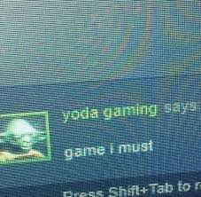
The Game

Slide 7

The Game
Fight your way through enemy creatures to escape a dungeon
Use WASD to move

Slide 8
The Game
Use Space to dash
Left click to shoot and mouse to aim
↑↓ to change weapons

Slide 9
The Game
Demonstration

Slide 10
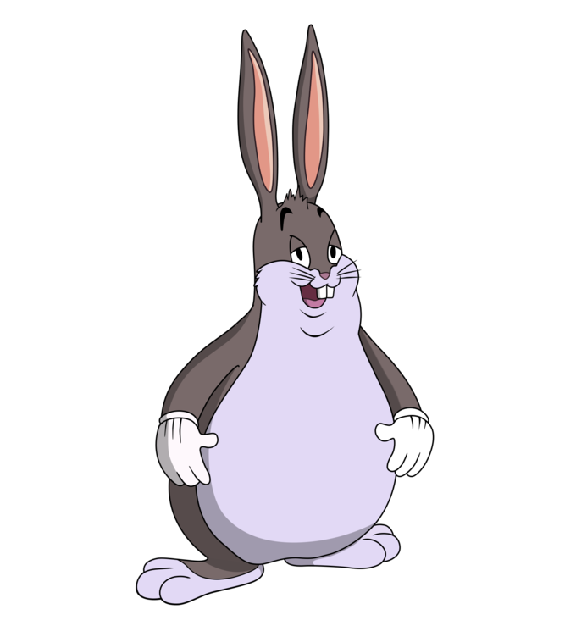
Known Bugs

Slide 11

Bugs pt 1
When pointing the cursor in certain locations, sometimes the bullet doesn’t travel to the origin of the cursor
When running the program for long periods of time, it takes longer to close

Slide 12
Bugs pt 2
If you repeatedly press space when the game starts, you will glitch off the map
Sometimes you spawn in between multiple enemies and get stuck

Slide 13
Object Overview

Slide 14

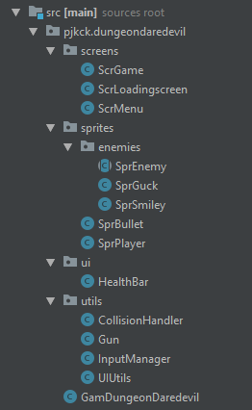
Object Overview

Slide 15
Challenges

Slide 16

Challenges
Being in a group of 3 and coordinating pushes and pulls
Properly sized/shaped hitboxes
Constantly changing architecture

Slide 17
What we learned

Slide 18
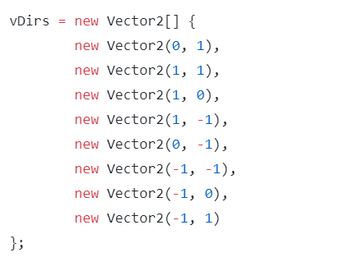
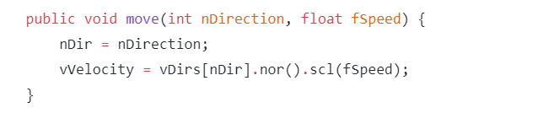
Vector Based Movement

Slide 19
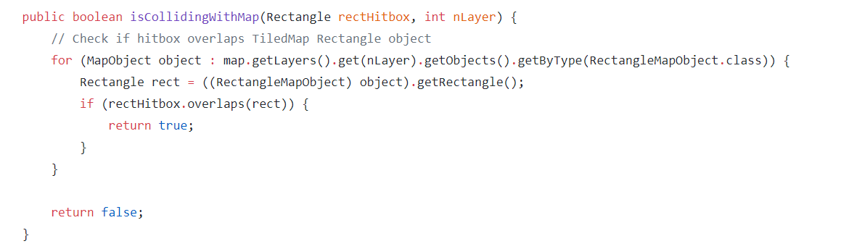
TiledMap Collision

Slide 20
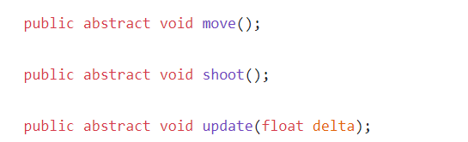




Abstract Classes

Slide 21
Lesson:
LibGDX Multiplayer with Node.JS

Slide 22
Overview
Server:
Contains an array of players with their location and IDs
Client:
Contains a list of all connected players
Communication using WebSockets

Slide 23
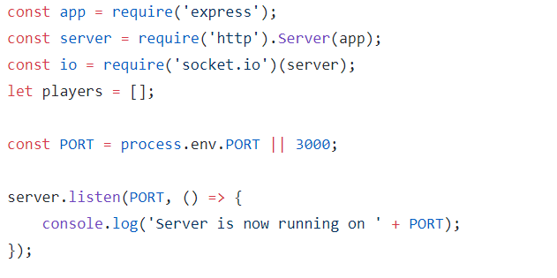
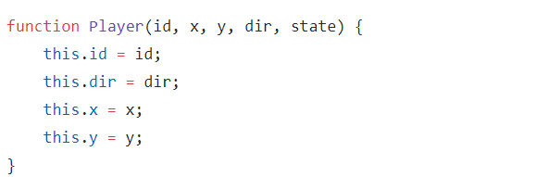
Server
Built using Node.JS and Socket.IO

Slide 24
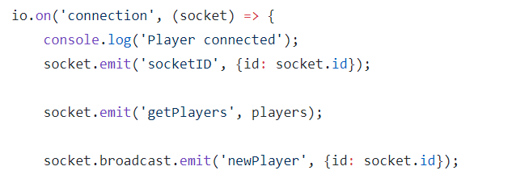
Server
Handling player connections

Slide 25
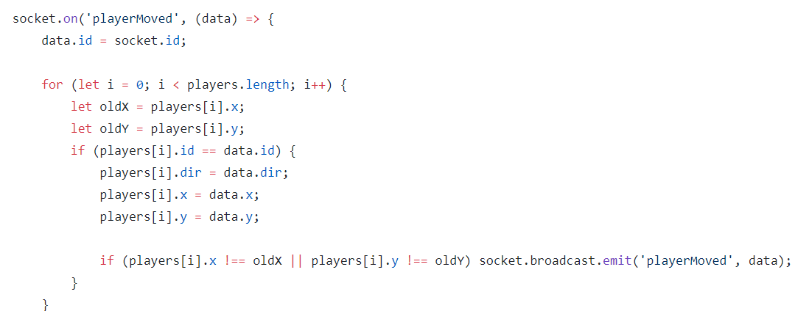
Server
Handling server events

Slide 26
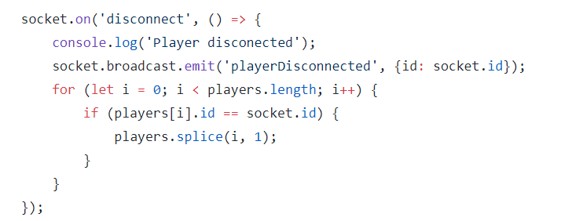
Server
Handling player disconnects

Slide 27
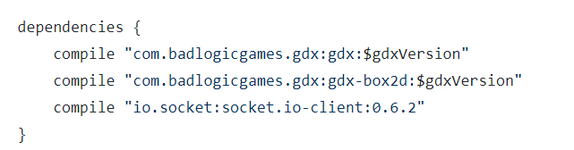
Client
Adding the Socket.IO library

Slide 28

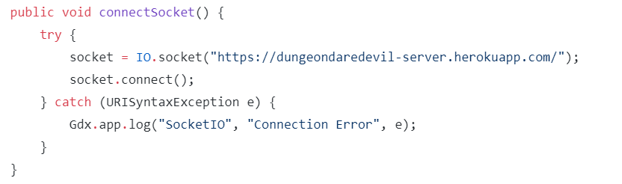

Client
Setting up our WebSocket

Slide 29
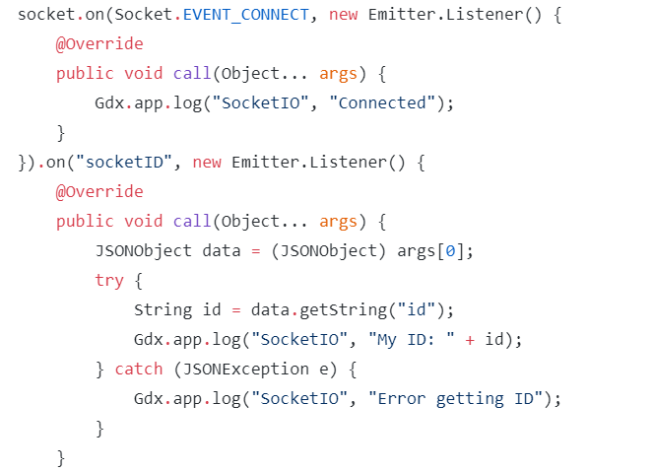
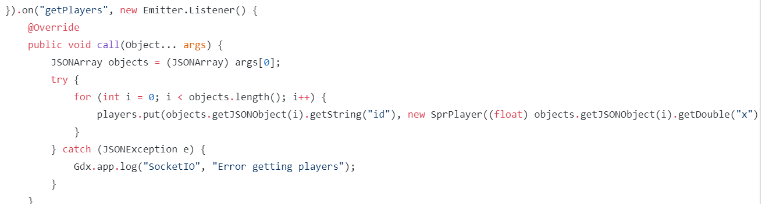
Client
Upon connecting to the server

Slide 30

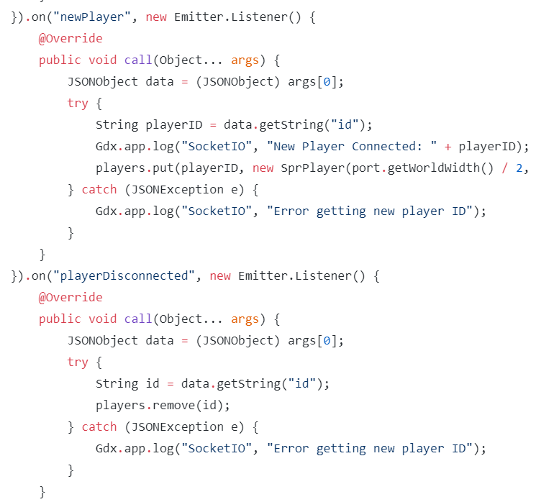
Client
Handling players joining and leaving

Slide 31
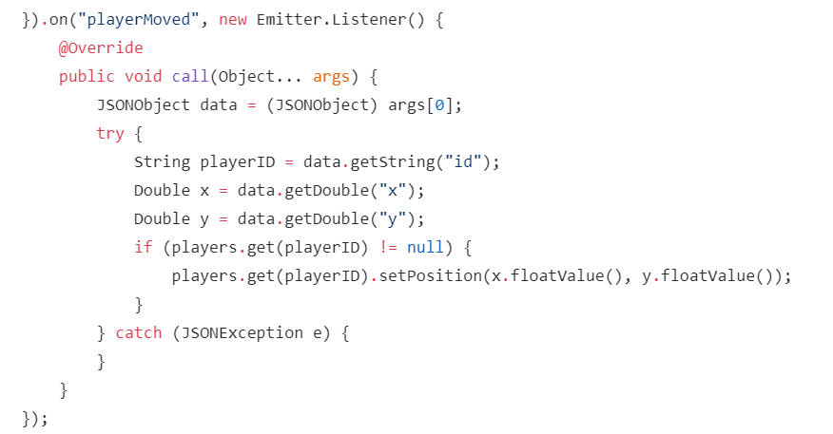
Client
Handling multiplayer movement

Slide 32
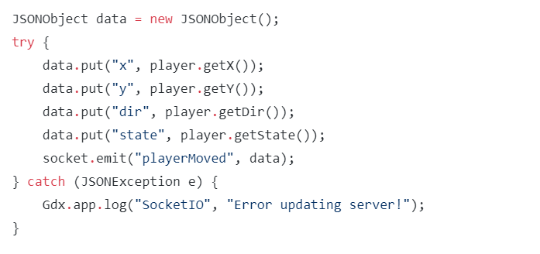
Client
Syncing up player location with server

Slide 33

Biggest Frustrations

Slide 34
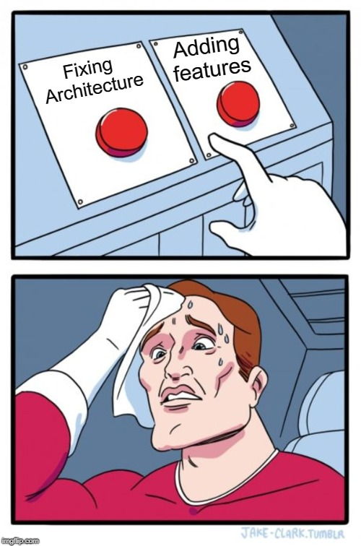
Frustrations
Fixing old code due to new features
Fixing efficiency of complex math equations
Github and LibGDX weren’t working together at home

Slide 35

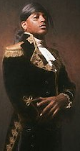
Notes to future programmers

Slide 36
Notes
Expand on the map to make it more complex
Add more unique enemies and levels
Continue on with the release schedule

Slide 37
Notes
Cleanup hitboxes to make bullets go on target
Fix bullets not landing at the origin of the cursor
Fix game closing much slower after running for a while

Slide 38
Dungeon Daredevil
Papa John’s Kool Coding Klub

